Slide 1


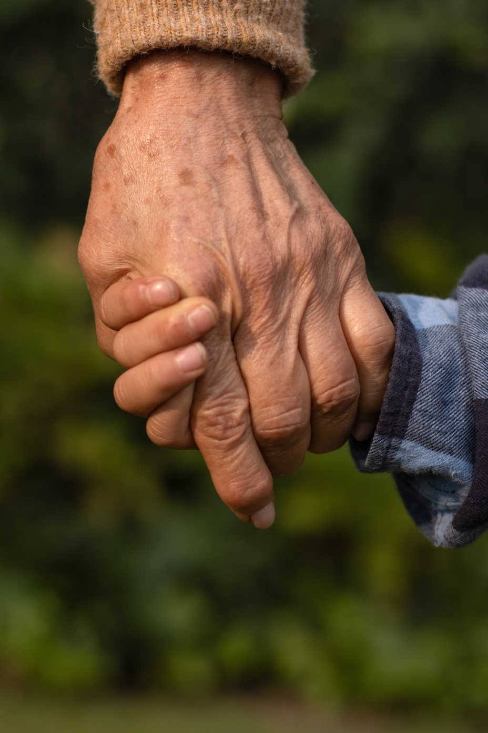



AI‑Enabled Safety and Communication for Older Adults
TalkAssist CareAssist
Supporting Physicians, Care Teams, and Families

Slide 2
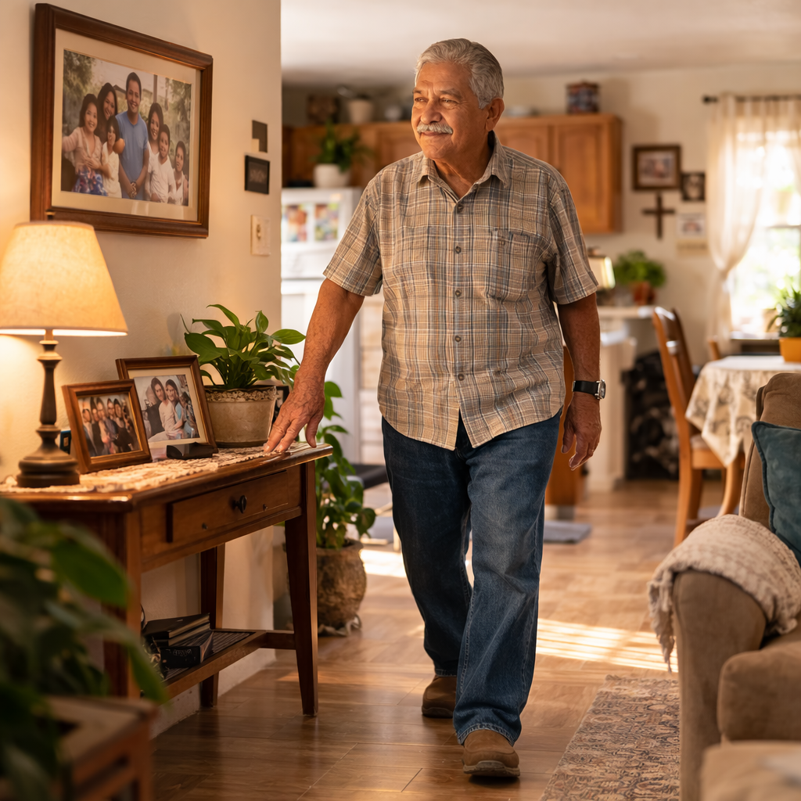
The Challenge for families and Physicians
Seniors spend most of their time outside clinical supervision
Early warning signs of decline often appear at home
Falls and health events frequently occur between visits
Families want independence for loved ones but also reassurance

Slide 3
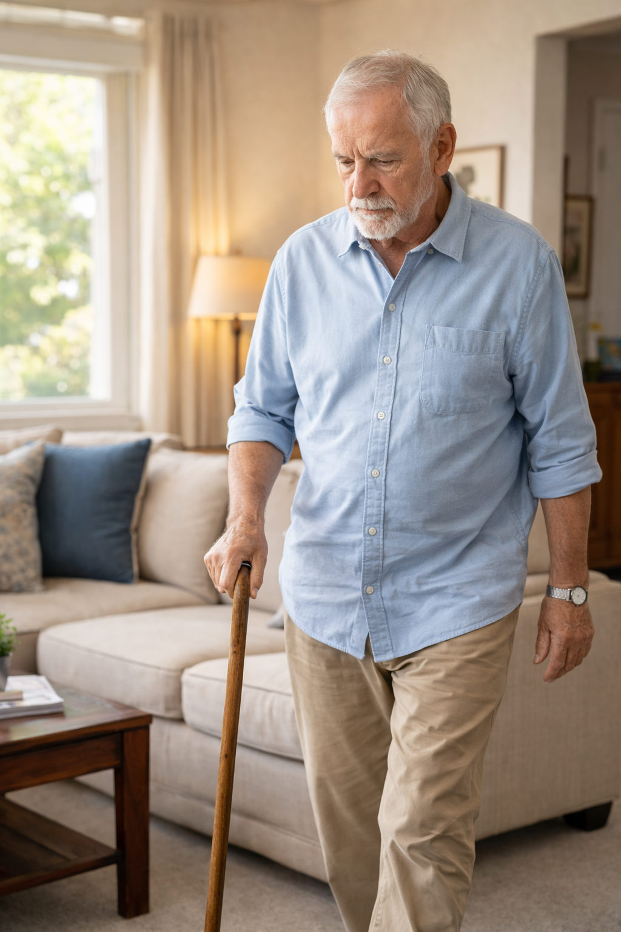
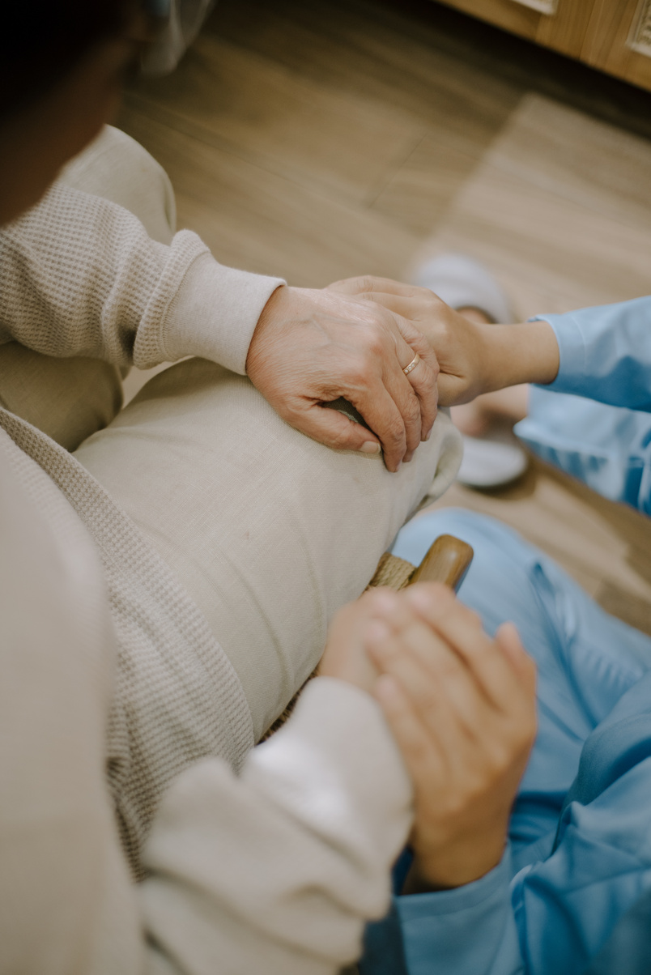
Physicians and families want the same outcomes:
A Shared Goal
Safe independence
Early detection of problems
Reduced hospitalizations
Better quality of life

Slide 4
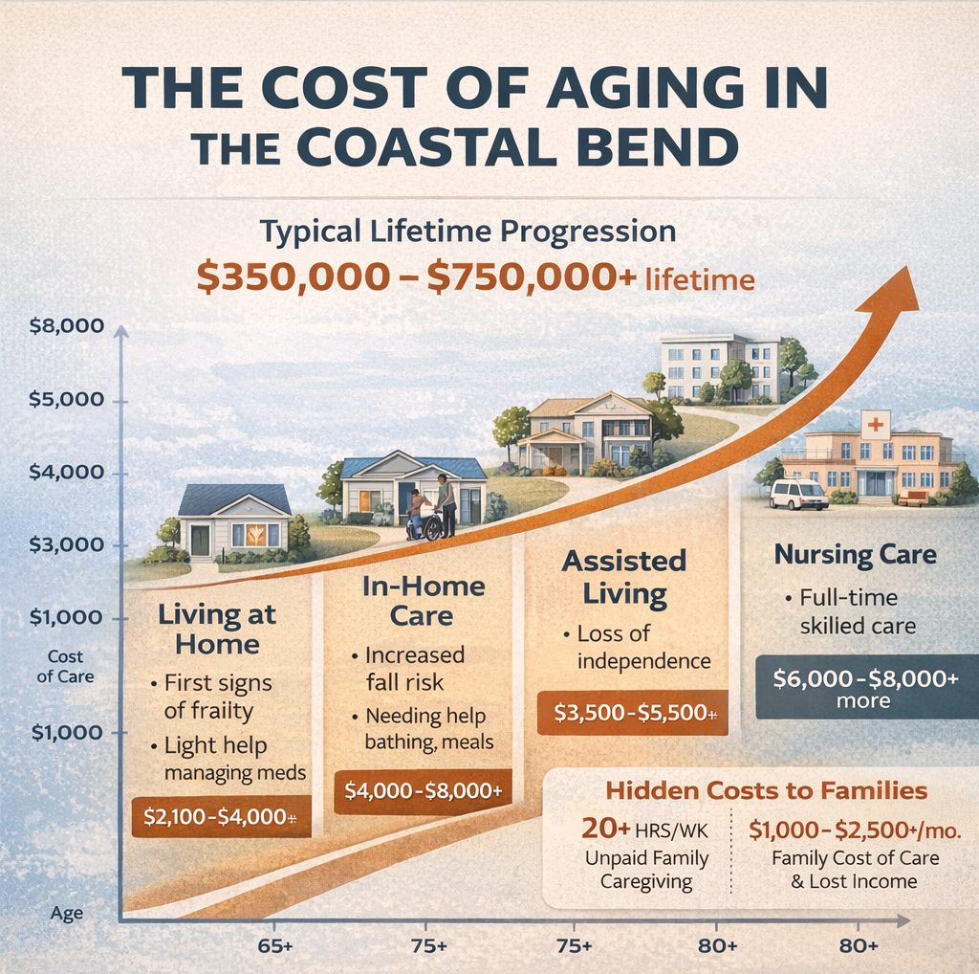
Annual Savings Estimate:
Fall prevention $10K–$30K
Reduced home care $12K–$18K
Avoided hospitalization $10K–$20K
Family burden reduction $6K–$15K
Total Annual Impact $38,000 – $83,000
If Grand App extends independent living by just 2–3 years:
Total savings: $100,000 – $250,000+
Grand App is a cost avoidance system.
Prevents a $30K fall
Delays $50K/year assisted living
Reduces $15K/year in family burden

Slide 5
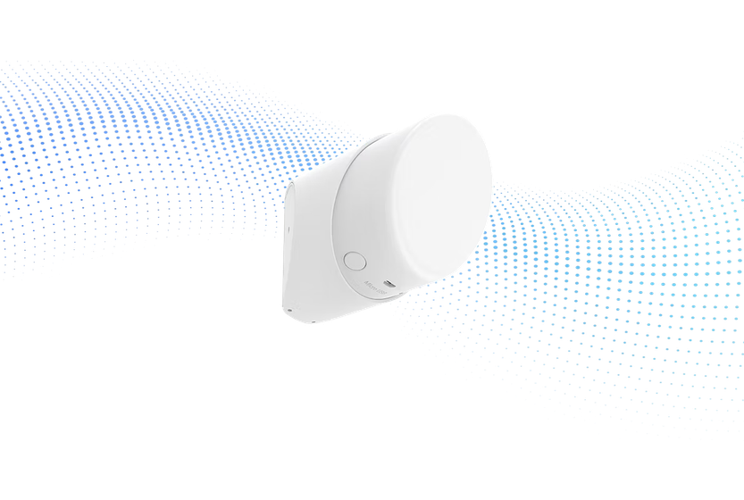
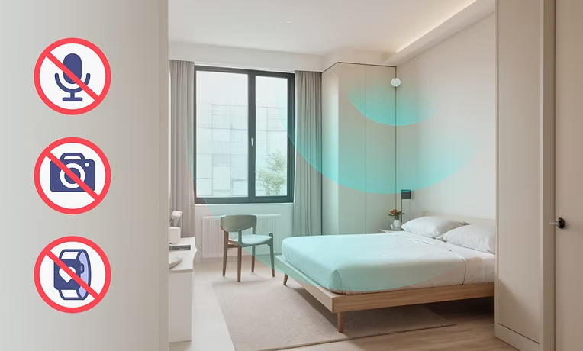
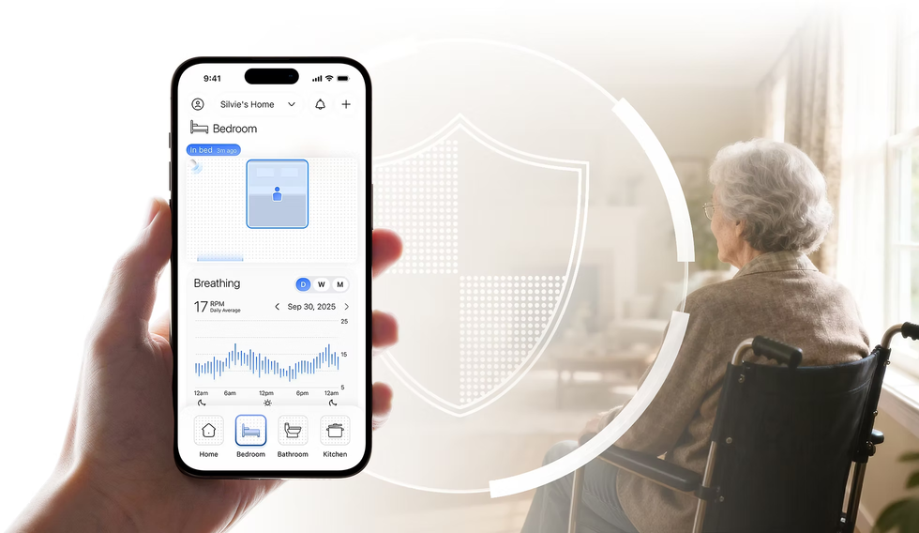
Care Assist
Designed to detect risks before emergencies occur
Proactive monitoring system that identifies changes in health patterns

Slide 6
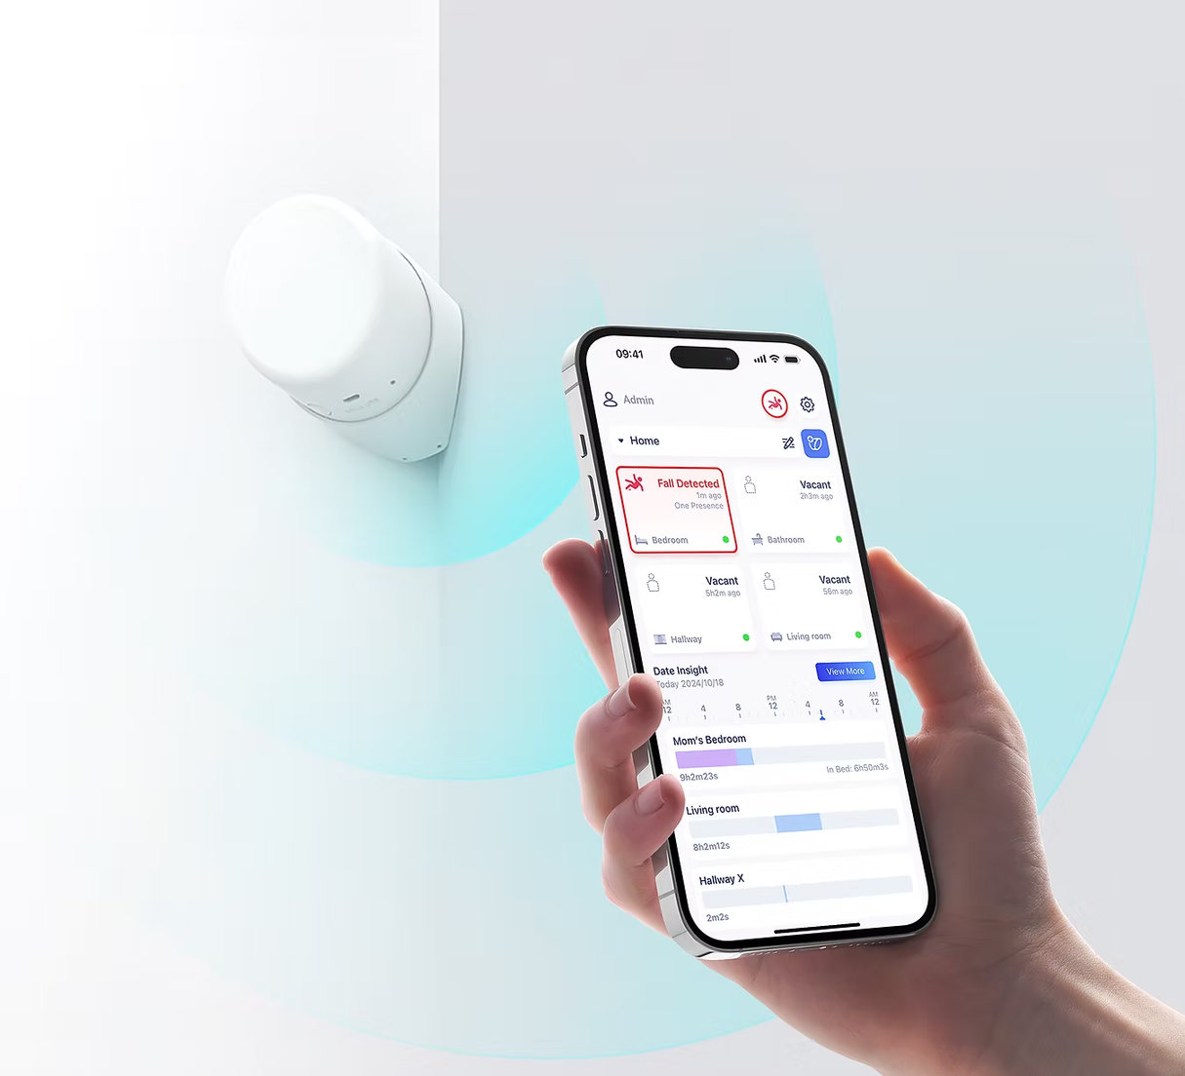
How CareAssist Works
Radar-based fall detection (no cameras)
Continuous motion monitoring
Sensors monitor activity patterns and provide insights
AI analyzes deviations from normal behavior

Slide 7
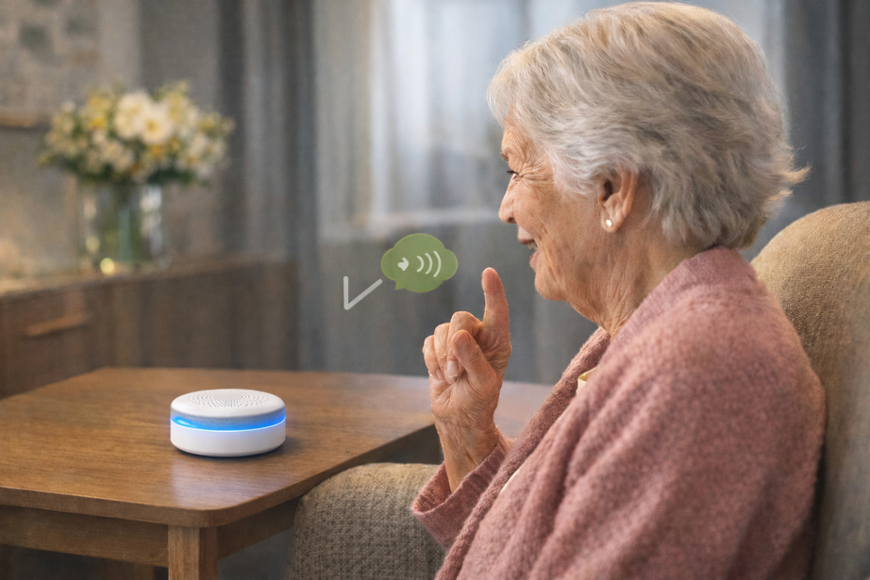
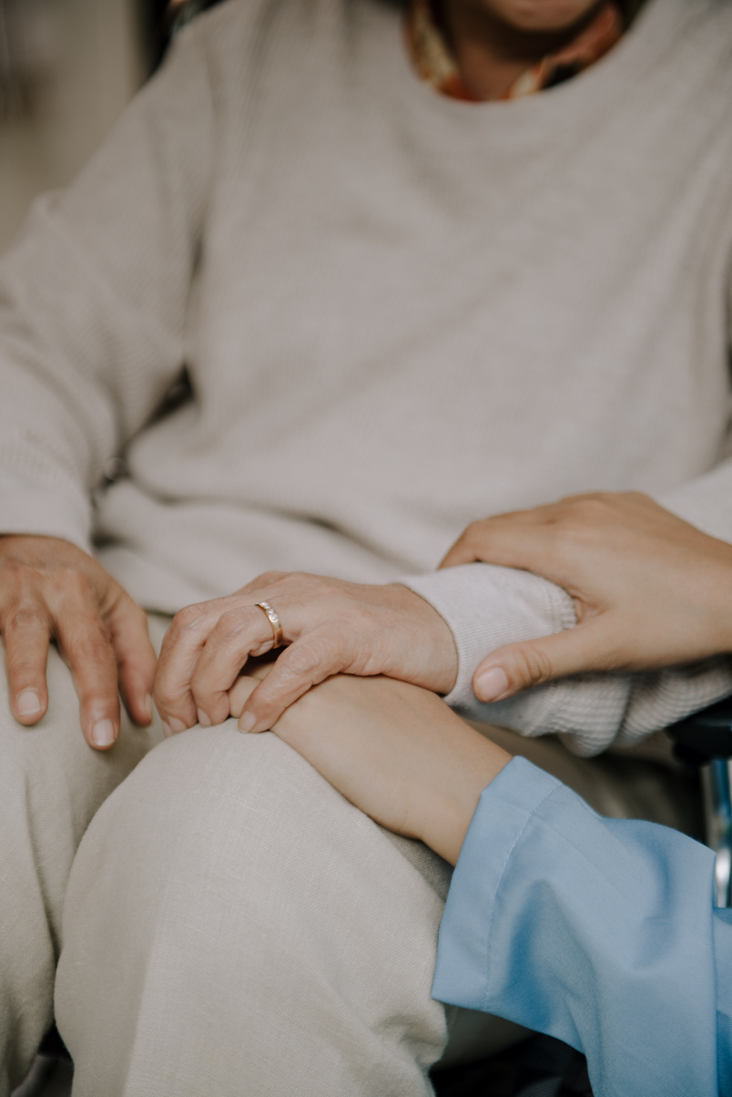
Talk Assist
Conversational alert system that turns silent alerts into real communication
Helps physicians and families understand what is happening during a safety event

Slide 8

How Talk Assist Works
Call buttons and panic alerts trigger conversation
AI conversational hubs placed in rooms and bathrooms
Staff or caregivers speak instantly with the resident
Situations are clarified before response is dispatched

Slide 9

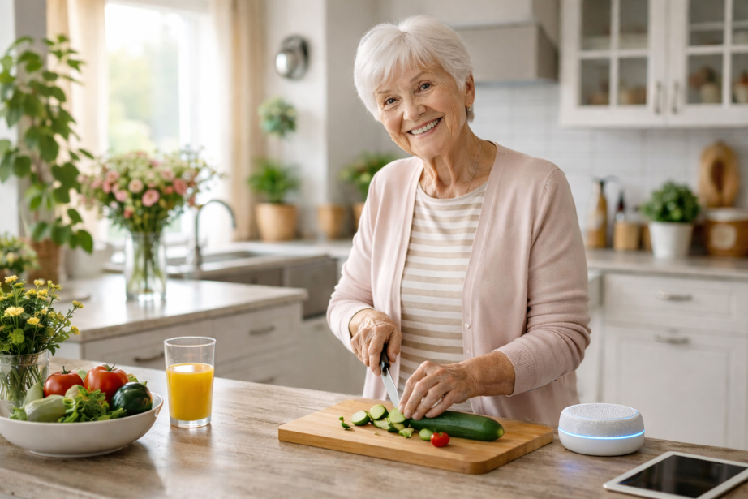
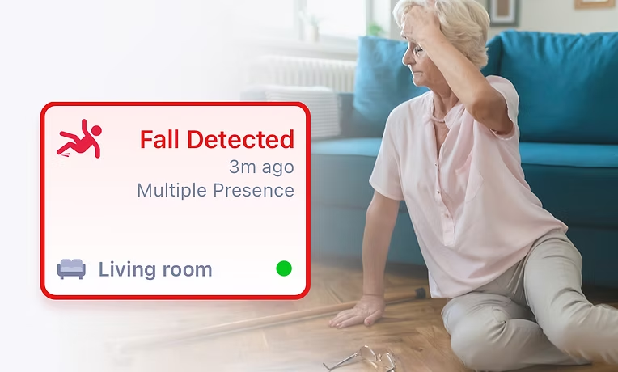
Faster response to emergencies
Fewer unnecessary alarms
Seniors feel heard rather than monitored
Families gain reassurance

Slide 10
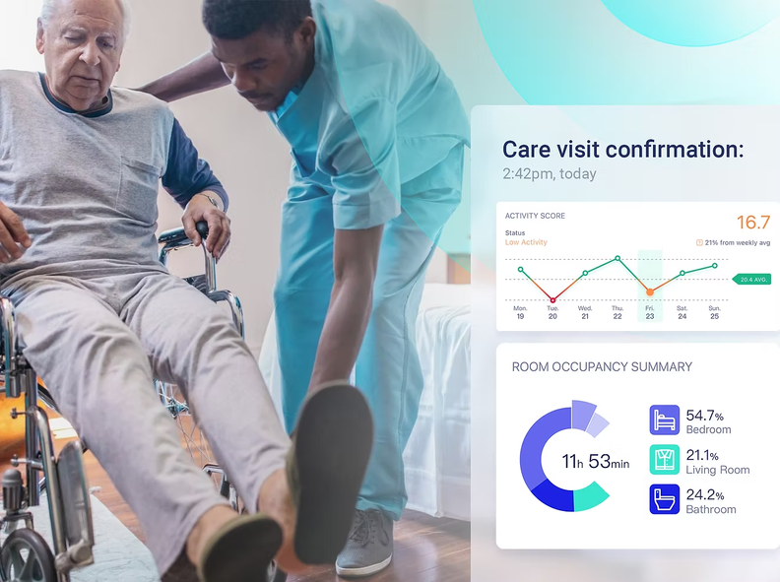
Clinical Value for Physicians
Early detection of mobility decline
Awareness of behavioral changes
Identification of abnormal sleep or idle patterns
Supports earlier medical intervention

Slide 11

Peace of Mind for Families
Loved ones remain independent at home
Families receive meaningful alerts
Clear communication during safety events
Greater confidence in care environment

Slide 12
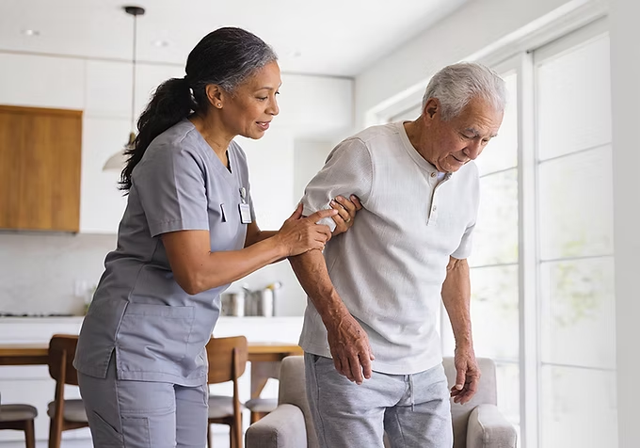

Earlier detection of health issues
Reduced falls and emergency events
Better coordination between care teams and families
Safer aging in place
Improved Outcomes

Slide 13

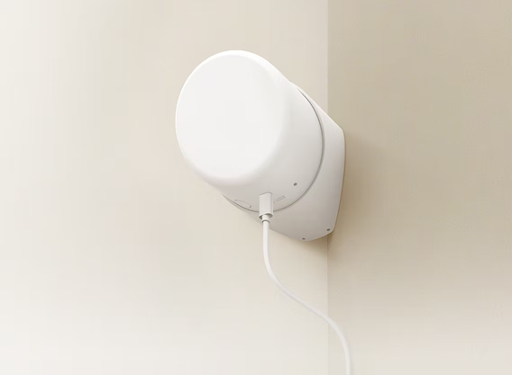
The Future of Senior Care
AI monitoring provides visibility between doctor visits
Helping physicians, caregivers, and families work together to protect older adults

Slide 14

Next Steps
TalkAssist CareAssist
Demonstrations
Referrals
Installations

Slide 15
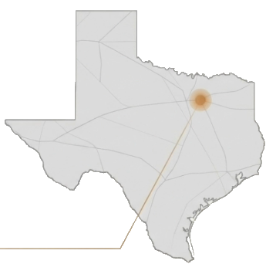
Take the First Step
Toward Smarter Care
Laura Ferring
Phone: (469) 873-3194
Email: laura@seniormatics.ai
Address: 4630 Long Prairie Rd
Flower Mound, TX 75028
(Offices located inside the GEICO office)
Locally Owned & Operated

